Slide 1

Software Cluster Final Presentation & Live App Demo
Ngo Guo Rui
1704754I
P03
Information Technology

Slide 2
Deliverables
Final Presentation will consist of the following:
Web App Value Positioning Statement > 1 slide
Test Report based on 2 Test Cases > 1 slide indicating which test cases. Show the Excel spreadsheet of the test cases.
Live Demo of Web App
Personal Reflection > 1 slide
To Upload deliverables to OneDrive (link will be given via email)
Final Presentation (PowerPoint file)
Test Report (Excel File)
Web App Project Folder (submit as a .zip file)

Slide 3
1. Web App Value Positioning Statement
Web App Value Positioning Statement
For | Anyone
Who | Wants to share reviews about the restaurants that they feel that it’s the best
The | Best Standard | is a | website
That | Allows people to be able to share their thoughts about the food/ restaurants that they like to everyone who is keen to know more about it

Slide 4
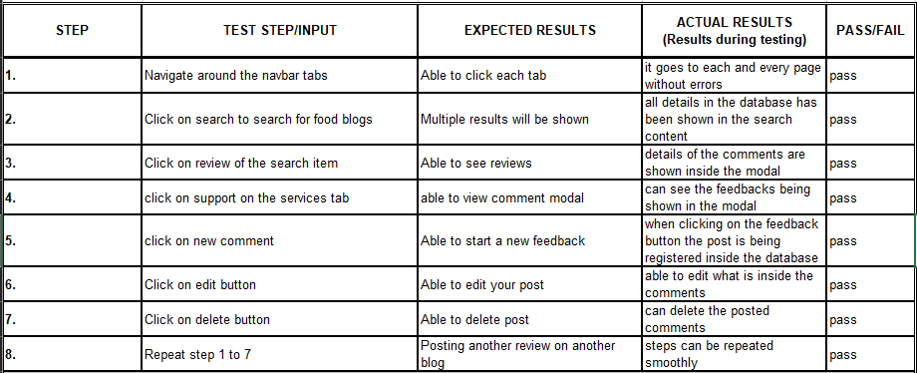
2. Test Report on 2 Test Cases
Exploring the website without being a member (TC003)

Slide 5
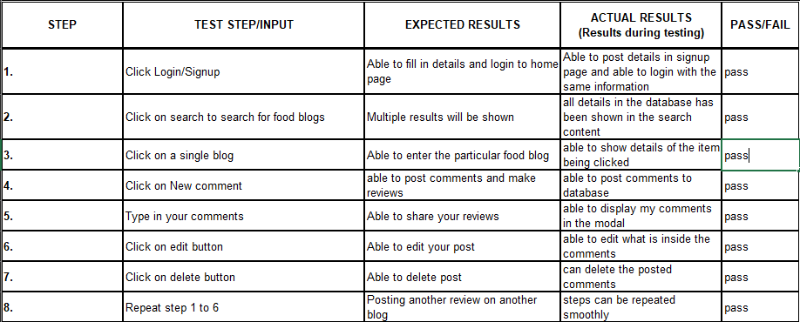
2. Test Report on 2 Test Cases
Signing up and exploring the website (TC002)

Slide 6
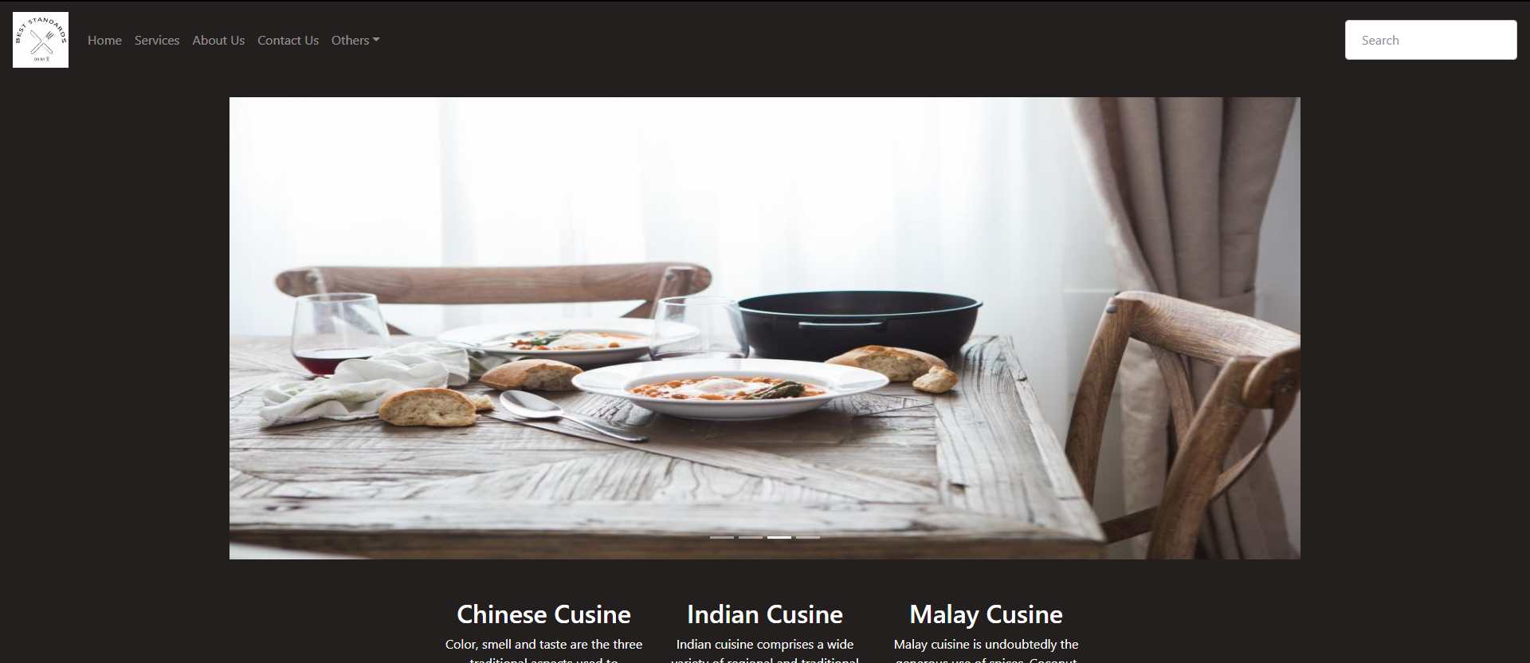
3. Live Demo of Web App

Slide 7
4. Personal Reflection
My overall experience was a positive one. I enjoyed the coding aspect of web development and I enjoyed having the to choose what I want for my website instead of sticking to one idea.
What I learnt most about was being able to use MySQL database and java script to actually make things easier for me instead of hardcoding everything
After completing the assignment, I can safely say now I am able to develop and design a web page using HTML, CSS, JavaScript and MySQL.
My experience from this whole assignment is 4 – good.

Slide 8
Thank You

